Slide 1
Symmetric Encryption – AES Cipher
Cryptography and Data Security
Mihai TOGAN
mihai.togan@mta.ro

Slide 2
Agenda
AES (Advanced Encryption Standard) Cipher

Slide 3

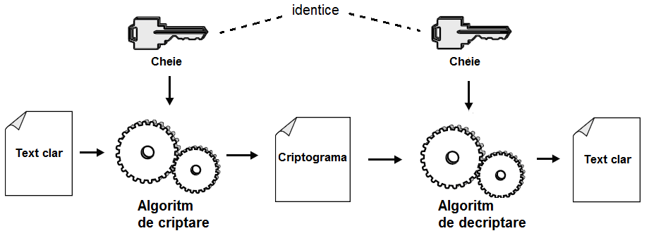

Symmetric ciphers
Sisteme de criptare cu cheie simetrica (secreta)
Trei algoritmi:
Algoritmul de generare de cheie
Algoritmul de criptare
Algoritmul de decriptare
K criptare $≅$ K decriptare

Slide 4
Algoritmul de criptare AES
(Advanced Encryption Standard)

Slide 5
AES – Initial Roadmap
Ianuarie 1997, initiativa NIST pentru generarea unui nou algoritm care sa inlocuie DES:
Open-Call pentru AES (Advanced Encryption Standard) cu urmatoarele cerinte:
Unclassified, publicly disclosed symmetric-key encryption algorithm(s)
The algorithm(s) must support (at a minimum) block sizes of 128-bits
The algorithm(s) must support (at a minimum) key sizes of 128-, 192-, and 256-bits
Should have a strength at the level of the triple DES, but should be more efficient then the triple DES
The algorithm(s), if selected, must be available royalty-free, worldwide
August 1998, NIST anunta un grup de 15 candidaturi (algoritmi)
Propuneri venite din comunitatea criptografica existenta la nivel global
Aprilie 1999, finalizare Runda 1: au rezultat 5 algoritmi selectati:
MARS, RC6, Rijndael, Serpent, Twofish
Runda 2: analiza publica urmarind mai multe topicuri, care includ: cryptanalysis, intellectual property, cross-cutting analyses of all of the AES finalists, overall recommendations and implementation issues.
15 Mai 2000: NIST anunta: castigatorul pentru AES este algoritmul Rijndael
Propus de 2 criptografi begieni: Daemen si Rijmen

Slide 6

AES Cipher
AES (Advanced Encryption Standard) este Standard Federal pentru Procesarea Informaţiei (FIPS)
Trei variante de cheie: 128/192/256 biti
Input block (plain-data): 128 biti (16 bytes)
Output (ciphertext): 128 biti (16 bytes)

Slide 7
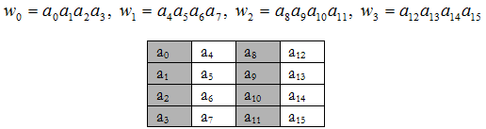
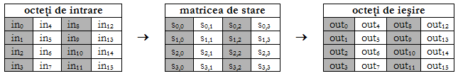
AES Cipher
Matricea de stare: matrice de 4 x 4 octeti:

Slide 8
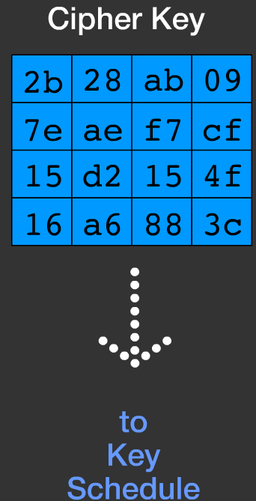
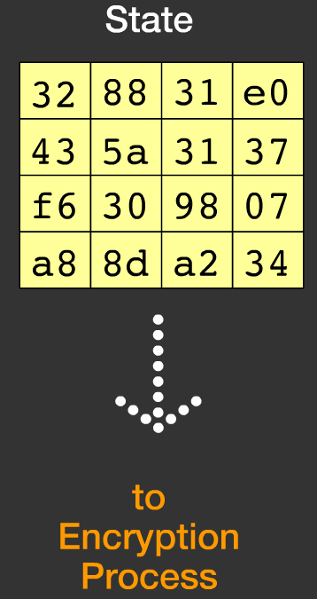
AES Cipher (cont.)
Key (input 1) expanded to round keys K1, K2, …K10
Round keys are used to encrypt the state matrix (data)

Slide 9
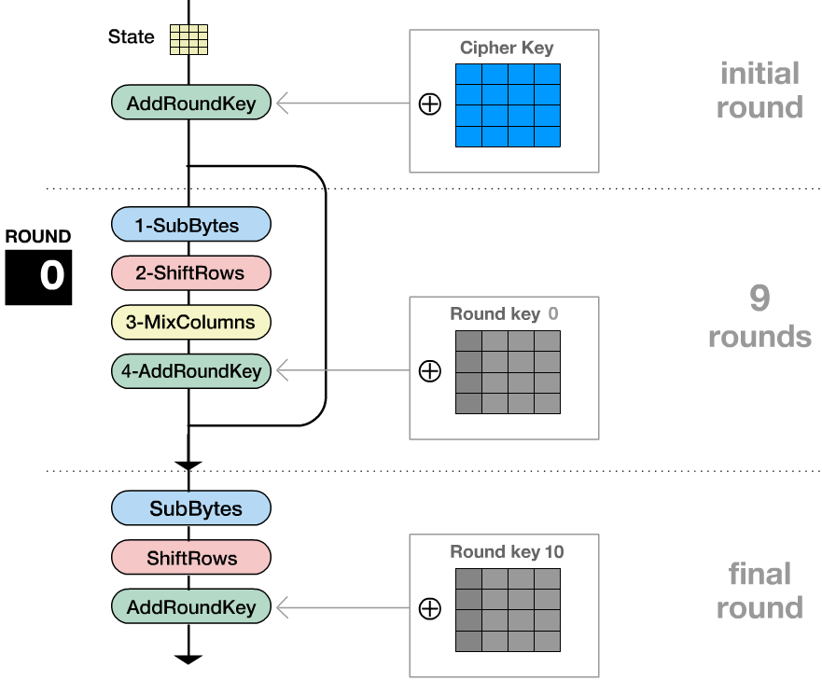
AES Cipher – Encryption Workflow

Slide 10
AES Cipher
Prezentare AES folosind rijndael_ingles2004.swf

Slide 11
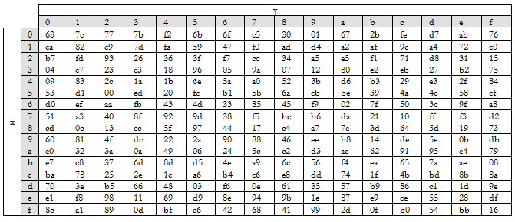
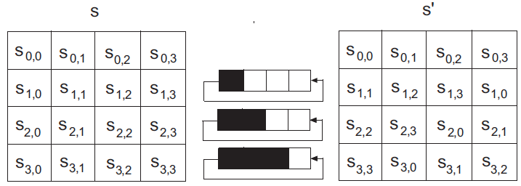
AES Cipher – Operations
AES Transformations
SubBytes (Substitution) – confusion
ShiftRows (Permutation) – diffusion
MixColumns (Permutation) – diffusion
AddRoundKey – XOR operation

Slide 12
AES Cipher – Operations
AES Transformations
SubBytes (Substitution) – confusion
ShiftRows (Permutation) – diffusion
MixColumns (Permutation) – diffusion
AddRoundKey – XOR operation
Substituie fiecare byte prin intermediul unei tabele de look-up (substitutie neliniara)
Shifteaza circular (rotire) fiecare linie astfel:
prima linie ramane neatinsa,
a 2-a linie cu 1 pozitie la stânga,
a 3-a linie cu 2 pozitii la stanga,
a 4-a linie cu 3 pozitii la stanga
Amesteca coloanele prin aplicarea unei transformări de această dată liniară şi reversibilă (este vorba de fapt de o multiplicare matriciala)

Slide 13
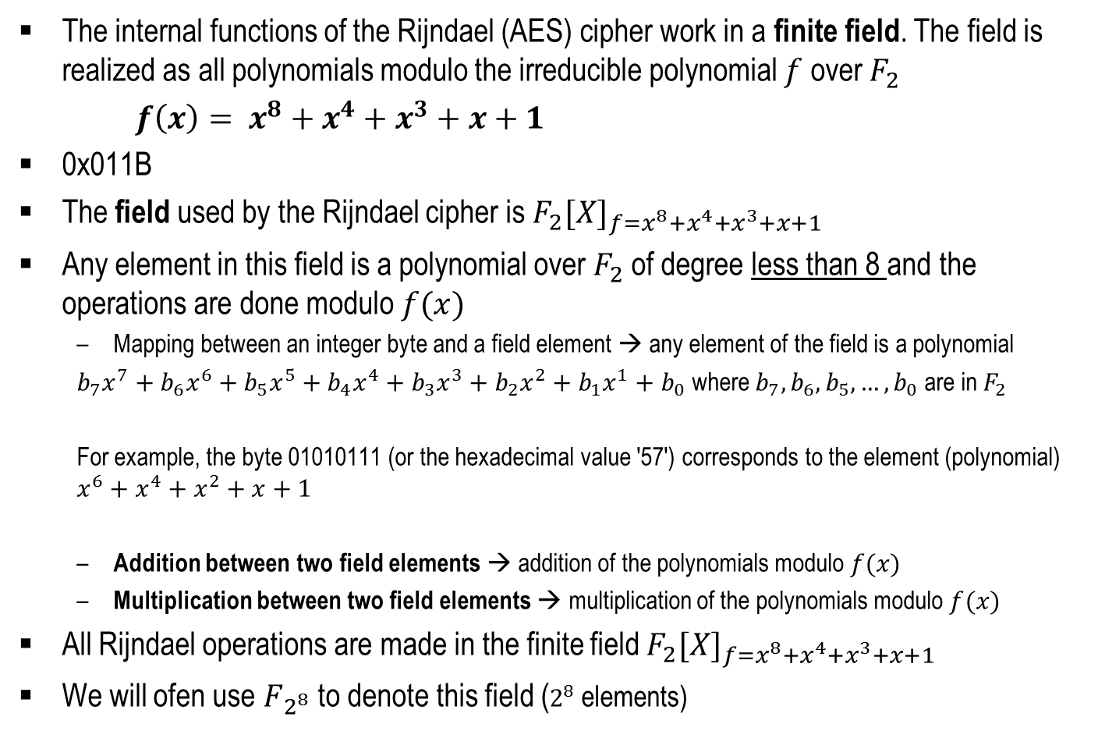
AES Cipher – Internals
The internal functions of the Rijndael (AES) cipher work in a finite field. The field is realized as all polynomials modulo the irreducible polynomial $f$ over $F_{2}$
$f\left(x\right)= x^{8}+x^{4}+x^{3}+x+1$
0x011B
The field used by the Rijndael cipher is $F_{2}{[X]}_{f=x^{8}+x^{4}+x^{3}+x+1}$
Any element in this field is a polynomial over $F_{2}$ of degree less than 8 and the operations are done modulo $f(x)$
Mapping between an integer byte and a field element → any element of the field is a polynomial
$b_{7}x^{7}+b_{6}x^{6}+b_{5}x^{5}+b_{4}x^{4}+b_{3}x^{3}+b_{2}x^{2}+b_{1}x^{1}+b_{0}$ where $b_{7}, b_{6},b_{5},…, b_{0}$ are in $F_{2}$
For example, the byte 01010111 (or the hexadecimal value '57') corresponds to the element (polynomial) $x^{6}+x^{4}+x^{2}+x+1$
Addition between two field elements → addition of the polynomials modulo $f(x)$
Multiplication between two field elements → multiplication of the polynomials modulo $f(x)$
All Rijndael operations are made in the finite field $F_{2}{[X]}_{f=x^{8}+x^{4}+x^{3}+x+1}$
We will ofen use $F_{2^{8}}$ to denote this field ($2^{8}$elements)

Slide 14
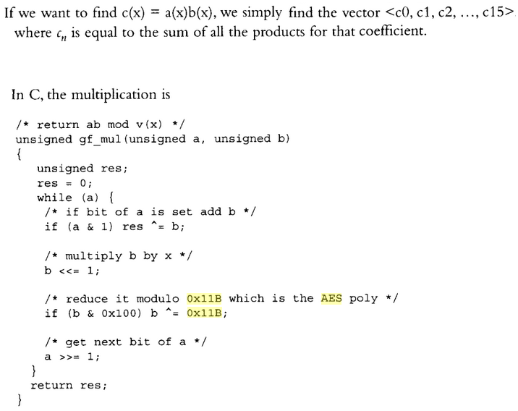
AES Cipher – Internals (contd.) C implementation of the AES-field multiplication)
Exercise (!!): make some tests using this code

Slide 15
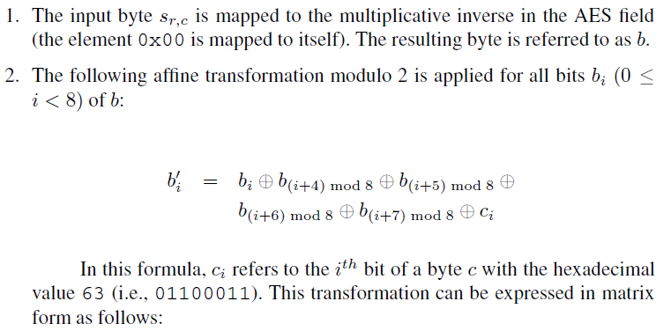
AES Cipher – Internal Function SubBytes (state)
Contrary to many other symmetric encryption systems (inlcuding, for example, the DES), the S-box of the AES has a well-documented design.
It is constructed by composing the following two transformations:

Slide 16
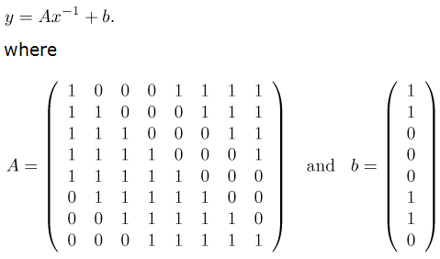

AES Cipher – Internal Function SubBytes (state) cont.
Provides a non-linear substitution on each byte (i.e., x) of State.
Any non-zero byte $x ∈ F_{2^{8}}$ is substituted by the following transformation:
Note: if x is the zero byte, then y = b is the SubBytes transformation result
Non-linearity of the transformation comes from the inversion $x^{−1}$ only
If the transformation be applied on x directly, the affine equation would then be absolutely linear!
Since the 8 x 8 constant matrix A is an invertible one, then the transformation in is invertible. Hence, function SubBytes (State) is invertible.

Slide 17
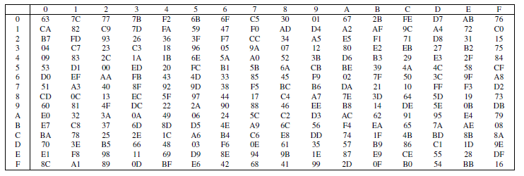
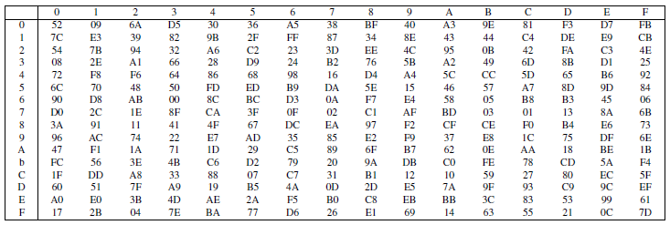
AES Cipher – Internal Function SubBytes (state) cont.
Lookup tables (S-boxes)
The S-Box of the AES Encryption Algorithm
The Inverse S-Box of the AES Decryption Algorithm

Slide 18
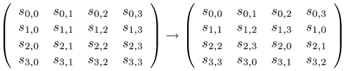
AES Cipher – Internal Function ShiftRows (state)
This function operates on each row of State.
For the case of 128-bit block size, it is the following transformation:
This operation is actually a transposition cipher
It only rearranges the positions of the elements without changing their identities
For elements in the i-th row (i = 0, 1, 2, 3), the position rearrangement is "cyclic shifting to right" by 4 – i positions
Since the transposition cipher only rearranges positions of the row elements, the transformation is of course mechanically invertible

Slide 19


AES Cipher – Internal Function MixColumns (state)
This function operates on each column of State.
MixColumns(State) repeats four iterations (one for each column).
The following description is for one column only (the output of an iteration is still a column):
If we have the column this column is interpreted into a 3-degree polynomial:
The operation on the column s(x) is defined by multiplying polynomial s(x) with a fixed degree-3 polynomial c(x), modulo x⁴ + 1
where the fixed polynomial c(x) is
It can be argued* (exercise !!) that in the above 3-degree polynomial, the coefficient for x^{i} (i = 0, 1, 2, 3) is the sum of cjsk satisfying j + k = i (mod 4) (where j, k = 0, 1, 2, 3)
* https://en.wikipedia.org/wiki/Rijndael_MixColumns

Slide 20
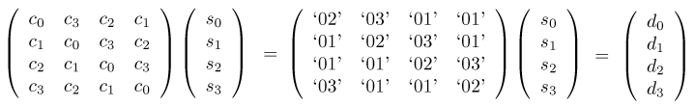
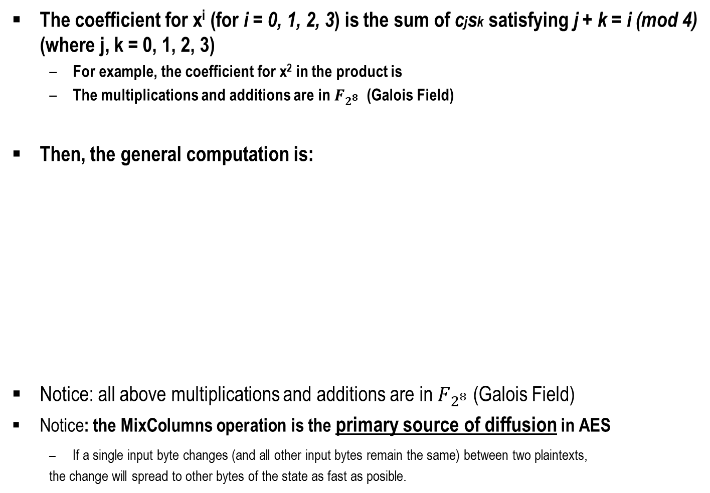
AES Cipher – Internal Function MixColumns (state) (cont.)
The coefficient for x^{i} (for i = 0, 1, 2, 3) is the sum of cjsk satisfying j + k = i (mod 4) (where j, k = 0, 1, 2, 3)
For example, the coefficient for x² in the product is
The multiplications and additions are in $F_{2^{8}}$ (Galois Field)
Then, the general computation is:
Notice: all above multiplications and additions are in $F_{2^{8}}$ (Galois Field)
Notice: the MixColumns operation is the primary source of diffusion in AES
If a single input byte changes (and all other input bytes remain the same) between two plaintexts,
the change will spread to other bytes of the state as fast as posible.
MixColumn
matrix (constant)
Input State
Output State

Slide 21

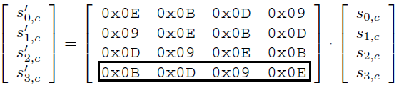
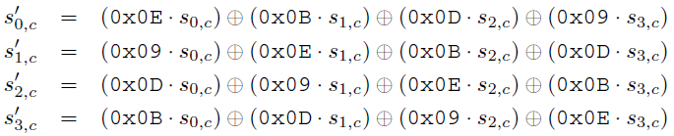
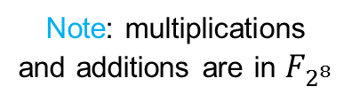
AES Cipher – Internal Function MixColumns (state) (cont.) – Decryption phase
We further notice that because c(x) is relatively prime to x⁴ + 1 over F2, the inversion c(x)^{–1} (mod x⁴ + 1) exists in F2[X].
This is equivalent to saying that the matrix, and hence the MixColumn transformation are invertible.
For decryption, the inverse transformation is used
where
Then, the general computation is:
or:
Note: MixColumn⁻¹ matrix (constant)
Note: multiplications
and additions are in $F_{2^{8}}$

Slide 22
AES Cipher – Internal Function AddRoundKey (state, roundKey)
This function merely adds, byte by byte and bit by bit, the elements of RoundKey to those of State. Here "add" is addition in F2 (bit-wise XOR)
Notice: the function AddRoundKey is trivially invertible; the inversion is "add" itself.
The RoundKey bits have been "scheduled," i.e., the key bits for different rounds are different, and are derived from the key using a fixed (non-secret) "key schedule" scheme.

Slide 23
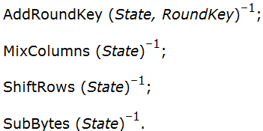
AES Cipher – Decryption
As we have seen that each of the four internal functions are invertible
The decryption is merely to invert the encryption in the reverse direction, i.e., applying:

Slide 24
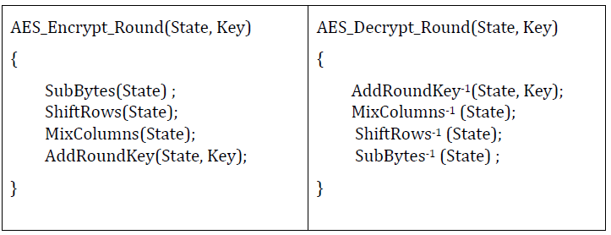
AES Cipher – Decryption (cont.)
In the case of a Feistel cipher, the encryption and decryption use the same circuit (hardware) or code (software).
Unlike in the case of a Feistel cipher, the Rijndael cipher must implement different circuits and codes for encryption and decryption, respectively:

Slide 25
AES Cipher – The roles of the Rijndael Internal Functions (Summary)
SubBytes is intended to achieve a non-linear substitution cipher
Non-linearity is an important property for a block cipher to prevent differential cryptanalysis
ShiftRows and MixColumns are intended to achieve a mixture of the bytes positioned in different places of a plaintext message block
Typically, plaintext messages have a low-entropy distribution in the message space due to the high redundancy contained in natural languages and business data (that is, typical plaintexts concentrate in a small subspace of the whole message space).
A mixture of the bytes in different positions of a message block causes a wider distribution of messages in the whole message space (diffusion)
AddRoundKey provides the necessary secret randomness to the message distribution
These functions repeat a plural number of times (minimum 10 for the case of 128-bit key and data size), and the result is the Rijndael (AES) cipher.

Slide 26
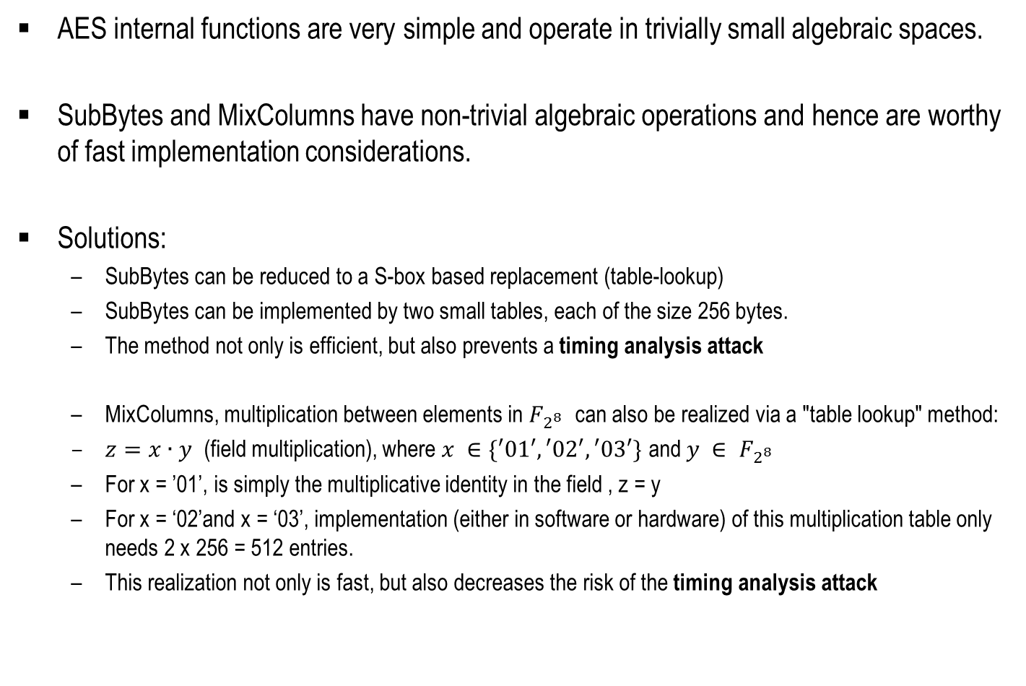
AES Cipher – Fast implementations
AES internal functions are very simple and operate in trivially small algebraic spaces.
SubBytes and MixColumns have non-trivial algebraic operations and hence are worthy of fast implementation considerations.
Solutions:
SubBytes can be reduced to a S-box based replacement (table-lookup)
SubBytes can be implemented by two small tables, each of the size 256 bytes.
The method not only is efficient, but also prevents a timing analysis attack
MixColumns, multiplication between elements in $F_{2^{8}}$ can also be realized via a "table lookup" method:
$z=x∙y$ (field multiplication), where $x ∈\{′01′, ′02′, ′03′\}$ and $y ∈ F_{2^{8}}$
For x = ’01’, is simply the multiplicative identity in the field , z = y
For x = ‘02’and x = ‘03’, implementation (either in software or hardware) of this multiplication table only needs 2 x 256 = 512 entries.
This realization not only is fast, but also decreases the risk of the timing analysis attack

Slide 27
AES Cipher – Conclusions
Rijndael was designed to have the following characteristics:
Resistance against all known attacks (KnownPlaintextA, ChosenPlaintextA, etc.)
Speed and code compactness on a wide range of platforms
Design simplicity

Slide 28
AES Cipher – Conclusions (cont.)
Suspiciunea principal cu privire la securitatea AES-ului este faptul ca foloseste un design destul de non-conformist (spre deosebire de schemele simetrice clasice, care se construiesc pe retea Feistel):
O reţea Feistel este o reţea bine studiată şi un cod construit pe reţea Feistel este puţin probabil să aducă surprize în ceea ce priveşte securitatea
Design-ul folosit la AES nu a fost sub atenţia comunităţii criptologilor decât în ultimii ani, de la propunerea AES-ului
În mod spectaculos, transformarea AES (Rijndael) este echivalenta cu o ecuatie algebrica destul de simpla (comparativ cu alte coduri) → exista suspiciunea că ar putea duce în viitor la o serie de atacuri
Până în prezent nu a apărut însă nici un atac spectaculos asupra acestui procedeu constructive.

Slide 29
AES Cipher – Conclusions (cont.)
NIST nu a gasit diferente de securitate intre finalistii AES.
Rijndael a fost selectat in principal datorita usurintei cu care poate fi implementat in hardware precum si datorita performantei pe aproape toate platformele.
Ca alternativă la Rijndael, poate fi utilizat oricare alt candidat la AES
Un bun contracandidat este codul Serpent, care nu este acoperit de nici un patent şi poate fi utilizat gratuit în soluţii contemporane de securitate (desigur acesta este mai lent decât AES) şi este construit pe structură Feistel

Slide 30
Using AES
openSSL - Exemple
Criptarea unui fisier 1.txt in fisierul 1.aes folosind algoritmul de criptare simetric AES si o cheie de criptare (folosire mod CBC):
openssl.exe enc –aes-128-cbc –e –in 1.txt –out 1.aes
–K 000102030405060708090A0B0C0D0E0F
–IV 00112233445566778899AABBCCDDEEFF

Slide 31
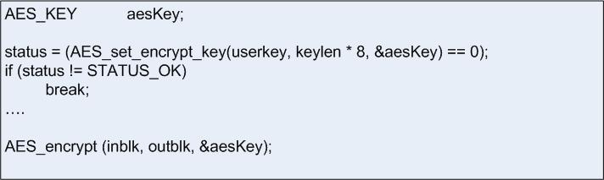
Using AES (contd.)
openSSL – Exemplu de aplicatie: criptare fisier folosind AES-ECB

Slide 32

Cryptography
Bibliography:
Wenbo Mao, Modern Cryptography: Theory and Practice
NIST FIPS PUB 197: the official AES standard

